Slide 1
Certificate Types

Slide 2
Root certificate
Public key certificate that denotes a root CA
Root certificate issues other certificates
Intermediate CA certificates derive from root
All other certificates
Access to the root certificate allows for the creation of any trusted certificate
Highly valued prize of hackers
Utmost security required

Slide 3
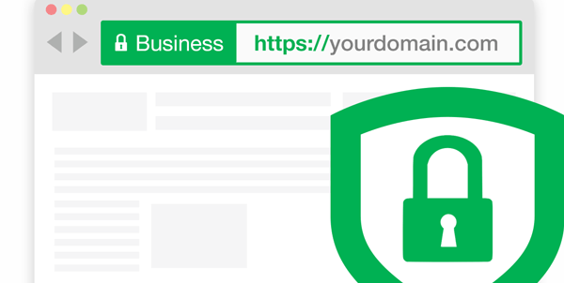
Web server SSL certificates
Domain Validation certificate (DV)
Owner of the certificate has control over DNS domain
Extended Validation Certificate (EV)
Additional checking has verified the certificate owner’s identity
Usually identified by name in address bar on modern browsers

Slide 4
Web server SSL certificates
Subject Alternative Name (SAN)
Extension of an X.509 certificate
Lists additional information for identification
Allows certificate to support other domains
Ex: google.com, 1e100.net, gmail.com, etc.
Wildcard domain
Certificates based on server name
Wildcard domain applies to all server names within domain
Ex: *.cyber.org

Slide 5
Self-signed certificates
Internal certificates don’t need public CA
Only used internally
No need to purchase trust
Your network devices already trust you
Be your own CA
Issue your own internal, signed certificates
Use the CA certificate on all devices
Works like purchased certificate – but free!
Create computer/machine certificates – validates that machine

Slide 6

Email certificates
Encrypt emails
Encrypt using recipient’s public key
Decrypted emails
Decrypt with your private key
Digital signatures
Use private key to digitally sign an email
Validates source/author
Provides non-repudiation and integrity to email message

Slide 7
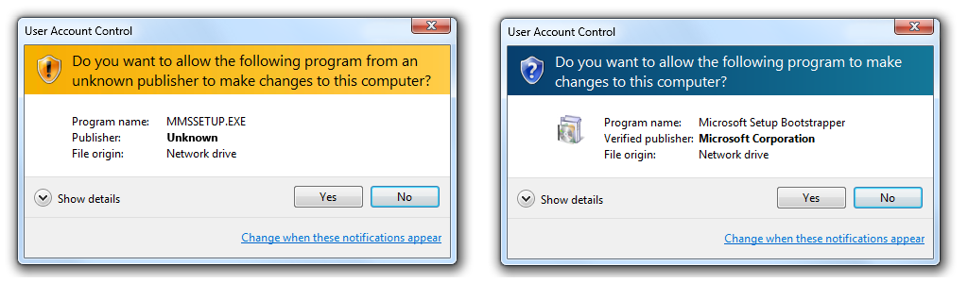
Code signing certificate
Applications can be signed by developer
Provides level of trust
The user’s operating system examines signature
Validates software has not been modified en route
Is software from trusted organization?
Who makes the software you just downloaded? Is it safe?

